Slide 1
Design Patterns

Slide 2
Singleton Pattern - Concept
Only one instance created
Guarantees control of a resource
Lazily loaded
Examples:
Runtime
Logger
Spring Beans
Graphic Managers
Notes:
The concepts when choosing a singleton are that it guarantees only one instance is going to be created. It also guarantees the control of a resource. Since this is a creational design pattern, the instantiation of it is all controlled through the implementation of the pattern. Although it doesn't have to be, it is usually lazily loaded. This ties in nicely with it being a creational pattern. Examples of this in the Java API or commonly used frameworks are the runtime environment, logger, but depending on the implementation this could be factory instead of singleton, and we will discuss this in more detail later, Spring Beans, if you've used the Spring framework at all, you will quickly learn that all Spring Beans are by default singletons. And a fourth example are graphics managers. Typically when you're using a Graphics API of any kind, you're going to get an instance of your graphical environment, and we only want one of those instances at a time.

Slide 3
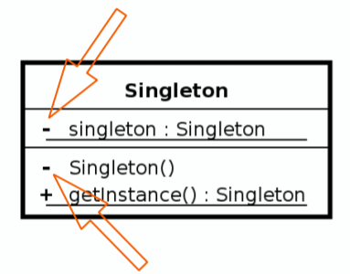
Singleton Pattern - Design
Class is responsible for lifecycle
Static in nature
Needs to be thread safe
Private instance
Private constructor
No parameters required for construction
Notes:
Design Considerations
The singleton is responsible for creating itself and managing its lifecycle. It is static in nature, although it is not implemented using a static class typically. The reason for not using a static class is that it needs to be thread safe, and static doesn't necessarily guarantee this for us. There is a private instance of a singleton, hence the minus sign or hyphen in the UML. There is also a private constructor that is marked the same way. This is because we want the singleton itself to call the constructor and nobody else. There are no parameters, and if you require parameters, that is typically a factory pattern and violates the rules of a singleton.

Slide 4
Singleton Pattern - Example
Runtime Env example
Runtime singletonRuntime = Runtime.getRuntime();
singletonRuntime.gc();
System.out.println(singletonRuntime);
Runtime anotherInstance = Runtime.getRuntime();
System.out.println(anotherInstance);
if(singletonRuntime == anotherInstance) {
System.out.println("They are the same instance");
}
Notes:
Example: Runtime
This is a code snippet of an everyday example using a singleton. We get an instance of the runtime environment and then print out the object address for it just so we can visually see what it is. We then get another instance of it and print out the address of that object as well. We can see that both objects are using the same object address by using the equals operator to compare them, and it will print out that they are the same object.
Demo: Runtime
In this example, you can see that we're going to go ahead and get an instance of the runtime environment, and then I went ahead and called garbage collect on here just so you could see it was the real runtime environment. Then we print out the object address using the System.out.println. Let me go ahead and grab another instance of it, print that address out, and you can see that they're the same object address. Then we'll use the equals operator just to again verify that they are the same object and print out the System.out.println. So if we go ahead and run this, you can see down below here that the object addresses are in fact the same and that it prints out that they are the same instance. So this is guaranteeing that we are in fact a singleton. This Runtime.getRuntime method is a singleton.

Slide 5
Singleton Pattern- Exercise
Create Singleton
Demonstrate only one instance created
Lazy loaded
Thread safe operation
Notes:
Exercise - Create Singleton
So let's go ahead and run an exercise to create our own singleton. In this demo, we're going to create a singleton, and then we're going to demonstrate that only one instance of our object is created. We're going to then go through and convert it to being lazily loaded and finally make it a thread‑safe singleton.

Slide 6
Singleton Pattern- Demo
Static Singleton
Notes:
Demo: Static Singleton
For our singleton exercise, we're going to go ahead and create a singleton to manage access to who can create connections to a database and where they can create them at. Let's right‑click on our package, com.designpatterndemo.singleton, and say New, Class. I'm going to name this class DbSingleton, and click Finish. And since we're going to build upon this example, I want to start off by not making this lazily loaded or thread safe. So we'll create an instance of our class by saying private static DbSingleton instance = new DbSingleton. And this will create an instance that our application can hold on to, and we'll manage it so that it only returns one instance of our application. To do so, we're going to create a private constructor so that people can't create new instances of this class on their own, and we'll just say private DbSingleton, and this will manage how that gets created so that people can't new up those new instances. Lastly, to flush out our singleton and control how people will grab that instance back, we're going to do the customary method with a singleton of saying public static DbSingleton, so it's going to return an instance of DbSingleton with a getInstance method. Now this is just a standard naming convention, it doesn't have to be called this, but it's customary with a singleton to have a getInstance method, and this will return that instance that we created up above. So there is everything we need to create our singleton. We have our static private instance that will hold on to, we have a private constructor so that people can't use the keyword new to create their own instance of it, and then we'll return that instance to the calling class when they call the getInstance method. And again, it's not required that it be called getInstance, it's just a standard convention when implementing a singleton. To test this, let's go ahead and create a class called DbSingletonDemo that will execute this code. So just type in DbSingletonDemo here, and I'm going to check the public static void main create and click Finish. And inside of here I'm going to replace this TODO with a DbSingleton instance, and remember that was a static method, so we'll call DbSingleton.getInstance to return an instance of our singleton for us. And to verify that this is running, I'm just going to do a System.out.println and return the object address that is created from that instance. And I can run this by right‑clicking on our main method and say Run As, Java Application. When this runs, you'll see that it prints out the object address in our console. We have for this time that I ran it a 56e88e24. Each time I run, it will return a different instance for me. But there's a couple of things to note here. Okay, we have a singleton. How do we verify that? Well, if we were trying to create a new instance of this since we did a private constructor, it won't allow us. So if I type in here DbSingleton, and we'll say testConst = new DbSingleton, it's not going to allow me to do this. See, in fact, it tries to suggest that I put the demo in here. If I take and close that off to the constructor, it tells me it won't allow me to do that. So it won't work that way, but let's test that we're only getting one instance of that object back. I can do that by recreating that line of the singleton again, saying Singleton anotherInstance = DbSingleton.getInstance. Now when I run this and I print out that object address again, it should print the same object address for me. So I'm going to copy and paste that down there and replace that with another instance. Save that, and right‑click and Run As again, Java Application, and you'll see that the object addresses are the same down there. So, it's not newing up another instance, it's returning that same object regardless of how many times I asked for it through that .getInstance method. So we've now created our first singleton. Let's move on to making this lazily loaded, and then we're going to follow that up with being thread safe.

Slide 7
Singleton Pattern- Demo
Lazy Loading
Notes:
Demo: Lazy Loading
To convert our singleton instance from being an eagerly loaded instance to being a lazy loaded instance is actually quite simple. Currently, it's eagerly loaded because on line 5 we're creating a new instance whether or not we use this. So all we need to do is grab this code, I'm going to copy it and change this to null, and then inside of our getInstance method, I'm going to do a simple null check and say if(instance) == null, then create a new instance of it. It's a very small change, and I will tell you right now that this isn't thread safe. We're going to talk about that in the next demo. But just changing this to being lazily loaded can be a substantial performance improvement for your application. I'm going to save this, switch back to our demo, and run this, and you'll see that it runs and executes exactly how we thought it would, and returns back our object addresses being the same across our original instance and our other instance. The difference here is just simply that we check to see that it's null and spool up that new instance. I've seen in large applications where we have a very slow startup because we're eagerly fetching all of those instances at the start up of our application. This will help it to where your app comes up quicker, and it's not such a memory hog when you're starting to spool up the application, it only uses what it needs. So, this can be a substantial improvement to your code and the performance of your code, which seems counterproductive where you're lazily loading it. Let's now look at making this thread safe.

Slide 8
Singleton Pattern- Demo
Threadsafe
Notes:
Demo: Threadsafe
At the time of the original recording of this course, the keyword volatile was actually new of that version of Java, so we didn't record it originally with that concept in mind. So one of the things we'll do to make this thread safe is we'll go up to line 5 here and say private static volatile, and this will help us ensure that that instance will remain a singleton through any of the changes inside of the JVM. The other thing we're going to do is to ensure that nobody uses reflection on our code. So we're going to go to this private singleton that we've made and say if instance does not equal null, then we are going to throw a new RuntimeException, and inside of here we'll just say Use getInstance method to create. And we'll close this. Now, that will create our instance to where it's volatile and can't be reinstantiated through different things going on in the JVM. This will also protect us from having a Reflection class go ahead and create an instance of this. Now the next thing we're going to do is we're going to come down to our getInstance method. Now, we could do this a couple of ways. We're going to implement a double‑checked locking mechanism and a synchronized check. Some people would originally on line 13 just make this whole method synchronized, and the problem with doing that is it's a performance hit. If we make this whole method synchronized every time we ask for an instance of it, we're going to actually synchronize that class and slow it completely down. Rather than doing that, let's go ahead and look and see if our instance is equal to null, and if it is, we're going to synchronize inside of here, so we'll say synchronized, and we're going to do it on the singleton, the DbSingleton class, and then we're actually going to check for null one more time. The idea behind this is that it's only going to actually happen if we're creating this one time, so it's a little bit of extra code, but it should only run if we're actually creating this for the very first time. So we'll do the exact same code again and we'll say if instance is equal to null, then create our instance of our DbSingleton. From there, we'll return back out our instance. So, we added our volatile to our instance, we protected this from being instantiated through reflection. Rather than synchronize on the whole method, we checked to see if the instance is equal to null, then we synchronized on it. And the reason for doing this is it may be null, but if two threads are trying to go at it, once we've synchronized and checked for null again, if another class has a lock on that, it will then block our code and create the instance and return that synchronized lock to where our code would now go back in and say, if this instance is null it would go, oh, no, I'm already created and returned back out of this. You can see how that double checked with volatile instance inside of there is handling that functionality inside of our class. Now, let's double check this by going back to our demo and running it again, and you'll see that it works correctly. You're not going to notice a real performance hit inside of our application now because we're only doing this with two instances across our main method. But, it does add a little bit of overhead with that synchronization inside of there. But at the safety of our application not having multiple threads accessing this and our singleton really not truthfully being a singleton, we're now lazily loaded, thread safe, and we're using the latest version of volatile inside the JVM to make this a fully thread safe instance of a singleton.

Slide 9
Singleton Pattern- Demo
Add Database
Notes:
Demo: Add Database
To make this an even more realistic example, I've gone ahead and added the Derby database JARs into our application to show you what this would look like to tie to a real database. Derby, if you're not familiar with it, is a very lightweight database that you can use for in‑memory applications, and a lot of times it's utilized for testing, and I've even used it in a few production settings as well. So the first thing we're going to do is register a driver, and rather than have you watch me type all of this in, I'm going to just paste in these snippets, and I've replaced our constructor with this code that goes through and creates an instance of the driver manager, and this will go through and register our database driver using that driver manager and check to see if our connection is not equal to null for a reflection like we had done in the previous demo. So, you'll notice this connection statement is erring out. We're going to take and create an instance of that connection in here. Let me grab that snippet, and we'll copy this and paste it in there. We're going to do the same thing as we had done before by creating a volatile instance of this, and let me import Connection. And then the next thing that we need to do is create our getConnection method inside of here. And this looks very similar to what we did with our getInstance, but there is one key difference here. Our getConnection is not static, and this is by design. And we could set this up one of a couple of ways, but I chose to do it this way because it's very similar to how we would do this in production applications. I've gone ahead and made this to where we have to have an instance of our singleton and then use that instance to get our connection. And so we're going to utilize the Singleton to call an instance of this class first and then get the connection and return that. To test this, let's switch over to our DbSingleton demo, and inside of here, we're going to clean this up a little bit. We've got our code left over from the previous demo. Let's go ahead and cut all of this out except for that DbSingleton.getInstance, and we'll start by just grabbing a connection, and you'll see I've got some other code here. We're actually going to run that in a second. And grab that connection, and then we can go through and utilize that instance. So, what we have here is us getting an instance of our singleton and then just grabbing that connection. Then let's grab our statement, and I have a statement already built down here, and we'll execute this code inside of our demo instance as well. And this code goes through and creates an instance of a table using a prepared statement to do so and handles the exceptions. I'm going to import all of those here, and we have a complete working example. So let's run this how it is, and we're going to add some performance metrics to this. Let's right‑click and say Run As, Java Application. You'll see that it goes through and it says that we've created our table. It just dumps out that System.out.println on line 20 and prints out Table created. That's great. Let's do some more sophisticated things with this code, though. So, I'm going to switch back over here to my notes, and I've got some longs that we're using to grab the timeBefore and the timeAfter, and we're going to time our connection creation gap to see how long it takes us to create this, and then we'll call it again when we're done with this and see how quickly it will create that connection for us. So, I grab that chunk of code and replace this connection here with that, and you'll see that we're just grabbing the timeBefore and the timeAfter using a System.currentTimeMillis. I'm going to print that difference out. But before we execute that, let's do that same thing after. I'm going to go down here and grab another timeBefore and another timeAfter and print that out once again. And you'll see here that it will execute and require very little to no time to run that instance.getConnection again. So let's save this, and now when we run this, you'll notice that the first time it runs it took 503 ms to create it, it says that our table is created, and the next time that it runs it's been optimized to where it took 0 ms because it is returning us that connection that we already have created. So we have our singleton of our instance, and then our connections inside of that singleton that's returning that in 0 ms, so it's optimized that code to where we only have one connection that we're sharing across this. The creation of that connection has been optimized to where it returns in 0 ms. It's just returning us back the connection we have. You can see some real performance benefits for us doing our singleton this way.

Slide 10
Singleton Pattern- Pitfalls
Often overused
Difficult to unit test
If not careful, not thread safe
Sometimes confused for Factory
java.util.Calendar is NOT a Singleton
Prototype
Notes:
Some of the pitfalls of a singleton are that they are often overused. Once people discover the power and simplicity of this pattern, they have a tendency to make everything a singleton when it doesn't necessarily need to be. Although there aren't generally performance problems with singletons, if you make everything a singleton, it will slow your application down. Since singletons don't expose an interface and have private constructors, as well as private member variables, they can often be difficult to unit test. If you aren't careful when implementing it, they're not thread safe. Oftentimes, people start off with a singleton that's static, like we demonstrated, and it ends up morphing into something else and can oftentimes be confused for a factory. They start making the getInstance method take parameters. A rule of thumb is that as soon as it needs an argument in that method, it is not a singleton anymore, but rather a factory. Although not a pitfall, the java.util.Calendar is not a singleton, it is actually more of a prototype pattern because you are getting a new unique instance every time you call the getInstance method. People often confuse this, though, because it uses that identifier of getInstance, which is typically associated with a singleton.

Slide 11
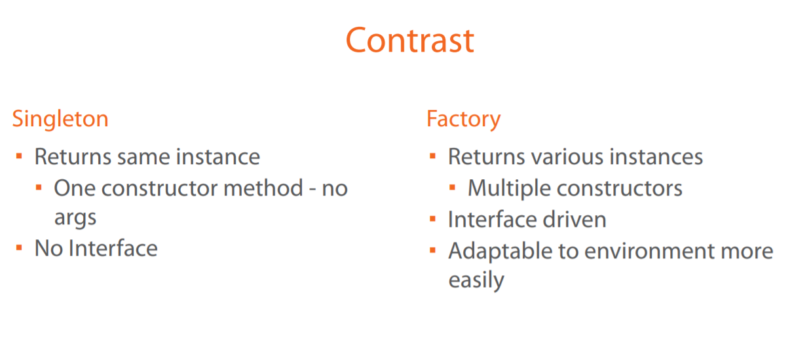
Contrast to other Design Patterns
Notes:
Contrast to Other Patterns
To contrast the singleton with another design pattern that it's commonly confused with, the factory, let's go through the two side by side so you can see the differences. A singleton will return the same instance every time. There is a one constructor method with no arguments, and notice how I label that as constructor method. The constructor is always private so you can't get access to it, so we have to access that through a construction method. And then there is typically no interface. Since this is a private constructor and a private instance inside of it, we don't expose an interface to help us adapt to different types of objects return. A factory, on the other hand, returns various instances, and, as the name implies, it returns multiple objects of various types. It also has multiple constructors because we're asking for those various types. There's different construction methods for us to get those instances back. It is usually interface driven. It's the opposite. We want to abstract out the back end and some of those things that we're returning so we usually do expose an interface with a factory, so it's a lot easier to unit testing and a lot easier to work with. It also has the ability to adapt to environments more easily than the singleton does. So, when you're looking at a singleton and it's not quite fitting, think about the factory and what the factory brings to the table, and some of these comparisons may help you in choosing a factory over a singleton, or a singleton over a factory.

Slide 12

Factory Pattern-Concept
Doesn’t expose instantiation logic
Defer to subclass
Common interface
Specified by architecture, implemented by user
Examples:
Calendar
ResourceBundle
NumberFormat
Notes:
Concepts
The concepts when choosing a factory are that it doesn't expose instantiation logic. The client knows next to nothing about even the type of object that is being created. It is able to do this by deferring the instantiation or a creation logic to the subclass. All the client typically knows about is a common interface that the factory exposes. Factories are oftentimes implemented by an architecture or a framework and implemented by the user of that framework. This establishes a contract for how things will be implemented within the framework, but allowing flexibility for the end user to define how it can be implemented. Examples of this in the Java API are the Calendar, ResourceBundles, and a NumberFormat. Oftentimes people think that Calendar is a singleton because it has no arguments or a no arguments constructor, and factory methods can have arguments. The difference is that a calendar can return different subclasses of the calendar and the client is unaware, whereas with a singleton you are just getting a single instance of that implementing class.

Slide 13
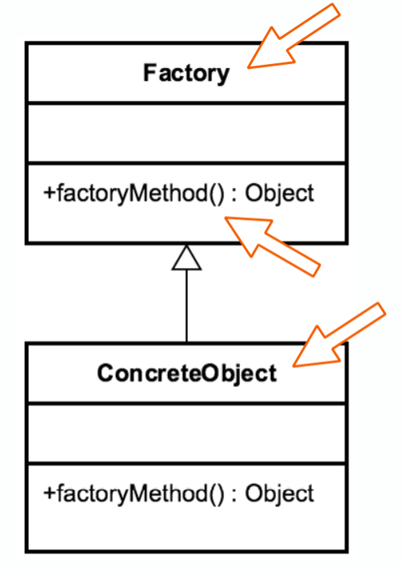
Factory Pattern-Design
Factory is responsible for lifecycle
Common Interface
Concrete classes
Parameterized create method
Notes:
I view the factory as almost being the opposite of the singleton. The factory is responsible for creating instances and managing the lifecycle, at least the creation part of the lifecycle. Objects created are referenced through a common interface. Factories will also reference multiple concrete classes or implementations, but the client is unaware since they are referenced through the common interface. The other key design principle is that the method to request an object is typically parameterized. These parameters are what are used to determine the concrete type. The UML diagram on the left shows the Factory, which is an implementation of the factory pattern. It has a factoryMethod, which will call and then return an interface to whatever object type we are attempting to build. The Factory itself refers to a concrete implementation that does the actual instantiation of our ConcreteObject. So we have our Factory class or our Factory abstract class that has a static factoryMethod that we are going to call, and based off of those parameters that we pass in, we're going to call a concrete instance that's going to return the object type for us.

Slide 14
Factory Pattern-Example
Calendar cal = Calendar.getInstance();
System.out.println(cal);
System.out.println(cal.get(Calendar.DAY_OF_MONTH));
Notes:
Example: Calendar
Here's an everyday example we use in Java all the time, and that is the actual Calendar class. So in this snippet of code, we go ahead and do Calendar.getInstance, which returns an instance of the Calendar class. And then on the next line I call System.out.println. Now this is to show you the actual object type that's going to be returned. This particular class will show you the implementing class it's underneath. So the concrete implementation rather the in the abstract base class that we're using. And then finally, just to show an example of how the code is being ran, I used the calendar.get and pass in a parameter of Calendar.DAY_OF_MONTH just to show that the object is working, how we think it should be.
Demo: Calendar
Here is that same example code that we were just looking at. I want to point out a couple of things. First when we run our code, it's going to go ahead and call our Calendar.getInstance, but we're not going to know exactly what type of calendar's going to be returned, and that's why I use this System.out.println here. So if we go ahead and run that, you'll see that the java.util.GregorianCalendar down here gets dumped out from that System.out.println, so the Gregorian calendar is the actual concrete implementation that's being called underneath this factory instance. Now another thing that I wanted to point out is that we can use different types of calendars, and that's what makes this different than some of the other design patterns because it is parameterized. So we can do Calendar cal = Calendar.getInstance, and you can see that there are different time zones available, locales, different things like that that we can call to get various types of calendars. So we could use a time zone from the East Coast, the West Coast, Pacific/Mountain, whatever, and get our calendar with that. So instead of like the singleton where I'm going to just get whatever object it says is available for me, I can get different types of calendars based just simply off of time zone or locale, so that's a nicer feature of the Calendar API, and really that's a feature of the factory method over singletons or some of the other creational design patterns that are out there.

Slide 15
Factory Pattern-Exercise
Create Concrete Classes
Create Factory
Enum
Notes:
Exercise - Create Factory
Now that we've seen an everyday example, let's look at what it would be like to write our own factory and go ahead and implement an exercise doing so. The next step will be to create the concrete classes that actually implement those features of creating the website. And then finally, we're going to create our factory. We're going to polish that last bit of our factory off by creating an enum that switches the logic in the factory based off of that enum.

Slide 16
Factory Pattern-Exercise
DEMO

Slide 17
Adapter Design Pattern
The adapter design pattern is a structural design pattern that allows two unrelated/uncommon interfaces to work together. In other words, the adapter pattern makes two incompatible interfaces compatible without changing their existing code.
Interfaces may be incompatible, but the inner functionality should match the requirement.
The adapter pattern is often used to make existing classes work with others without modifying their source code.
Adapter patterns use a single class (the adapter class) to join functionalities of independent or incompatible interfaces/classes.
The adapter pattern also is known as the wrapper, an alternative naming shared with the decorator design pattern.
This pattern converts the (incompatible) interface of a class (the adaptee) into another interface (the target) that clients require.
The adapter pattern also lets classes work together, which, otherwise, couldn't have worked, because of the incompatible interfaces.

Slide 18
Adapter Design Pattern
For example, let's take a look at a person traveling in different countries with their laptop and mobile devices. We have a different electric socket, volt, and frequency measured in different countries and that makes the use of any appliance of one country to be freely used in a different country. In the United Kingdom, we use Type G socket with 230 volts and 50 Hz frequency. In the United States, we use Type A and Type B sockets with 120 volts and 60 Hz frequency. In India, we use Type C, Type D. and Type M sockets with 230 volts and 50 Hz. lastly, in Japan, we use Type A and Type B sockets with 110 volts and 50 Hz frequency. This makes the appliances we carry incompatible with the electric specifications we have at different places.
This makes the adapter tool essential because it can make/convert incompatible code into compatible code. Please notice here that we have not achieved anything additional here — there is no additional functionality, only compatibility.

